Slide 1
Angular Day4
Presented By : Asmaa Ahmed

Slide 2
How Routing Works
Configure a route for each component
Define options/actions
Tie a route to each option/action Activate the route based on user action
Activating a route displays the component's view

Slide 3
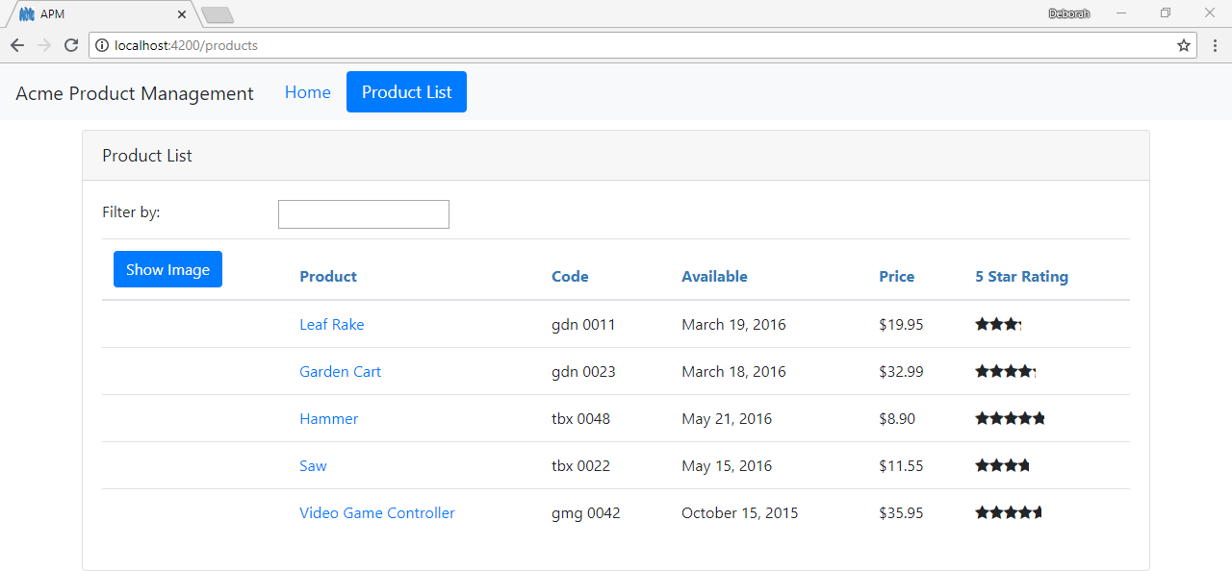
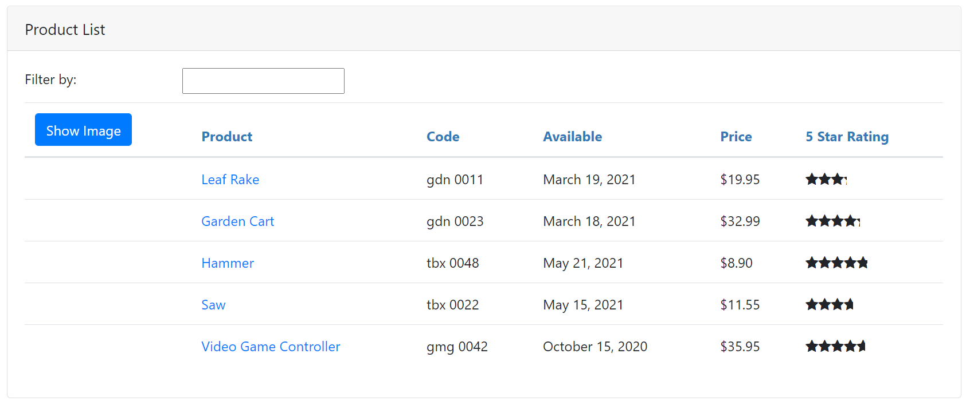
How Routing Works
<a routerLink="/products">Product List</a>
{ path: 'products', component: ProductListComponent }
product-list.component.ts
import { Component } from '@angular/core';
@Component({
templateUrl: './product-list.component.html'
})
export class ProductListComponent { }
<router-outlet></router-outlet>

Slide 4
Navigating the Application Routes
Menu option, link, image or button that activates a route
Typing the Url in the address bar / bookmark The browser's forward or back buttons

Slide 5
How Routing Works
<a routerLink="/products">Product List</a>
{ path: 'products', component: ProductListComponent }
product-list.component.ts
import { Component } from '@angular/core';
<router-outlet></router-outlet>
@Component({
templateUrl: './product-list.component.html'
})
export class ProductListComponent { }

Slide 6
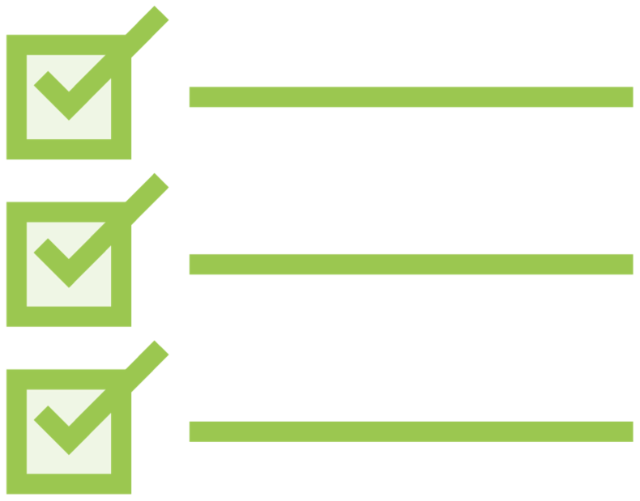
Routing Checklist:
Tying Routes to Actions
Add the RouterLink directive as an attribute
Clickable element
Enclose in square brackets
Bind to a link parameters array
First element is the path
All other elements are route parameters
<ul>
<li><a [routerLink]="['/welcome']">Home</a></li>
<li><a [routerLink]="['/products']">Product List</a><
/li>
</ul>

Slide 7
Passing Parameters to a Route
app.module.ts
@NgModule({ imports: [
...,
RouterModule.forRoot([
{ path: 'products', component: ProductListComponent },
{ path: 'products/:id', component: ProductDetailComponent },
{ path: 'welcome', component: WelcomeComponent },
{ path: '', redirectTo: 'welcome', pathMatch: 'full' },
{ path: '**', redirectTo: 'welcome', pathMatch: 'full' }
])
],
declarations: [...], bootstrap: [ AppComponent ]
})
export class AppModule { }

Slide 8
Passing Parameters to a Route
product-list.component.html
<td>
<a [routerLink]="['/products', product.productId]">
{{product.productName}}
</a>
</td>
app.module.ts
{ path: 'products/:id', component: ProductDetailComponent }

Slide 9
Reading Parameters from a Route
product-detail.component.ts
import { ActivatedRoute } from '@angular/router';
constructor(private route: ActivatedRoute) { }
app.module.ts
{ path: 'products/:id', component: ProductDetailComponent }

Slide 10



Reading Parameters from a Route
Snapshot : Read the parameter one time
this.route.snapshot.paramMap.get('id');
Observable: Read emitted parameters as they change
this.route.paramMap.subscribe(
params => console.log(params.get('id'))
);
Specified string is the route parameter name
{ path: 'products/:id',
component: ProductDetailComponent }

Slide 11
Activating a Route with Code
product-detail.component.ts
import { Router } from '@angular/router';
...
constructor(private router: Router) { }
onBack(): void { this.router.navigate(['/products']);
}

Slide 12
General Checklist: Null and Undefined
Prevent null or undefined errors in a template
- Safe navigation operator (?)
{{product?.productName}}
{{product?.supplier?.companyName}}
- *ngIf directive
<div *ngIf='product'>
<div>Name:</div>
<div>{{product.productName}}</div>
<div>Description:</div>
<div>{{product.description}}</div>
</div>

Slide 13
Routing Checklist: Passing Parameters
app.module.ts
{ path: 'products/:id', component: ProductDetailComponent }
product-list.component.html
<a [routerLink]="['/products', product.productId]">
{{product.productName}}
</a>
product-detail.component.ts
import { ActivatedRoute } from '@angular/router';
constructor(private route: ActivatedRoute) { console.log(this.route.snapshot.paramMap.get('id'));
}

